Slide 1
UK workbook
Presented by
Aftab Nafees
GitHub Username
Aftab1038
Repository Link
https://shorturl.at/CQYyc

Slide 2
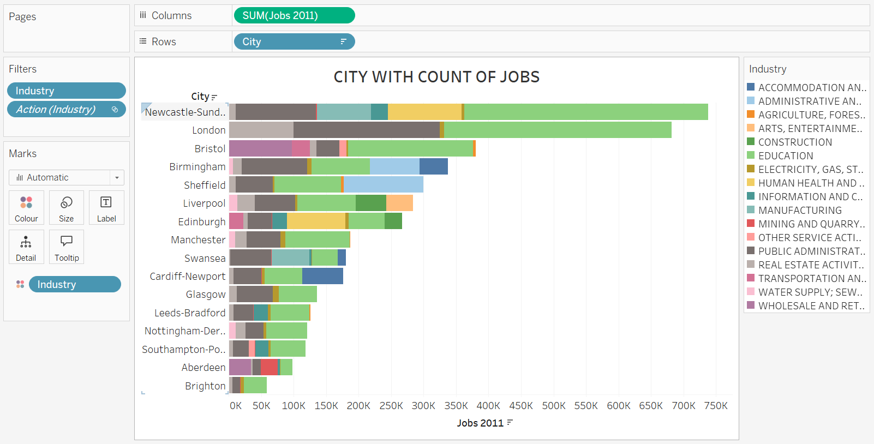

Slide 3
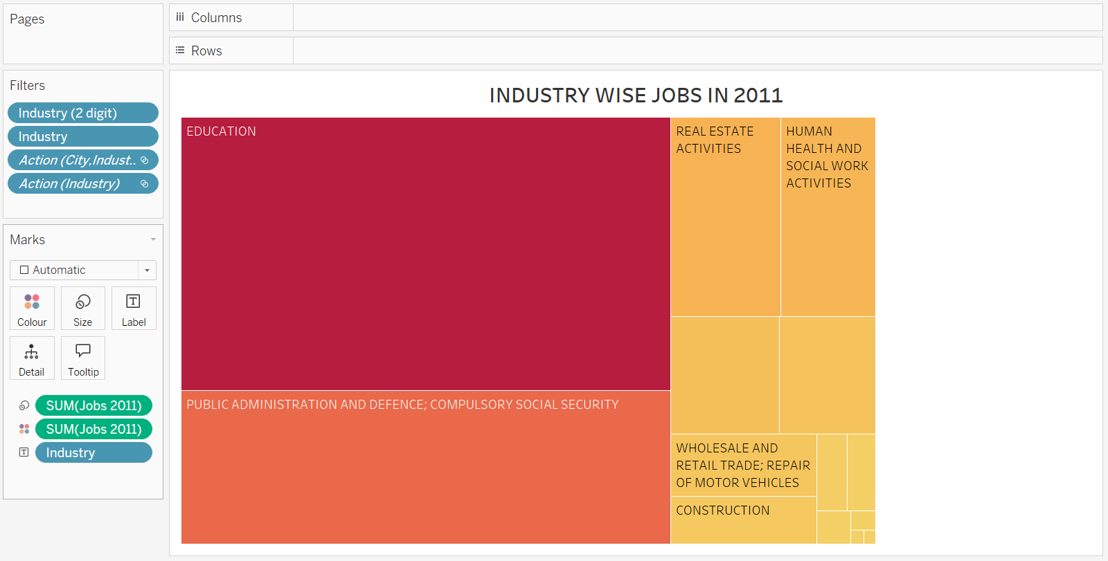

Slide 4
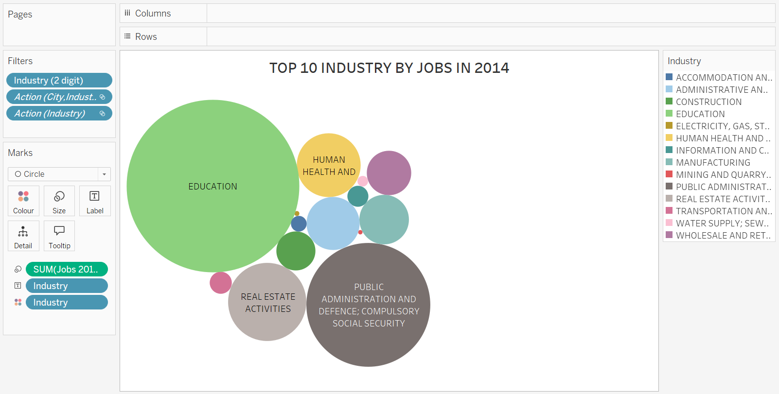

Slide 5
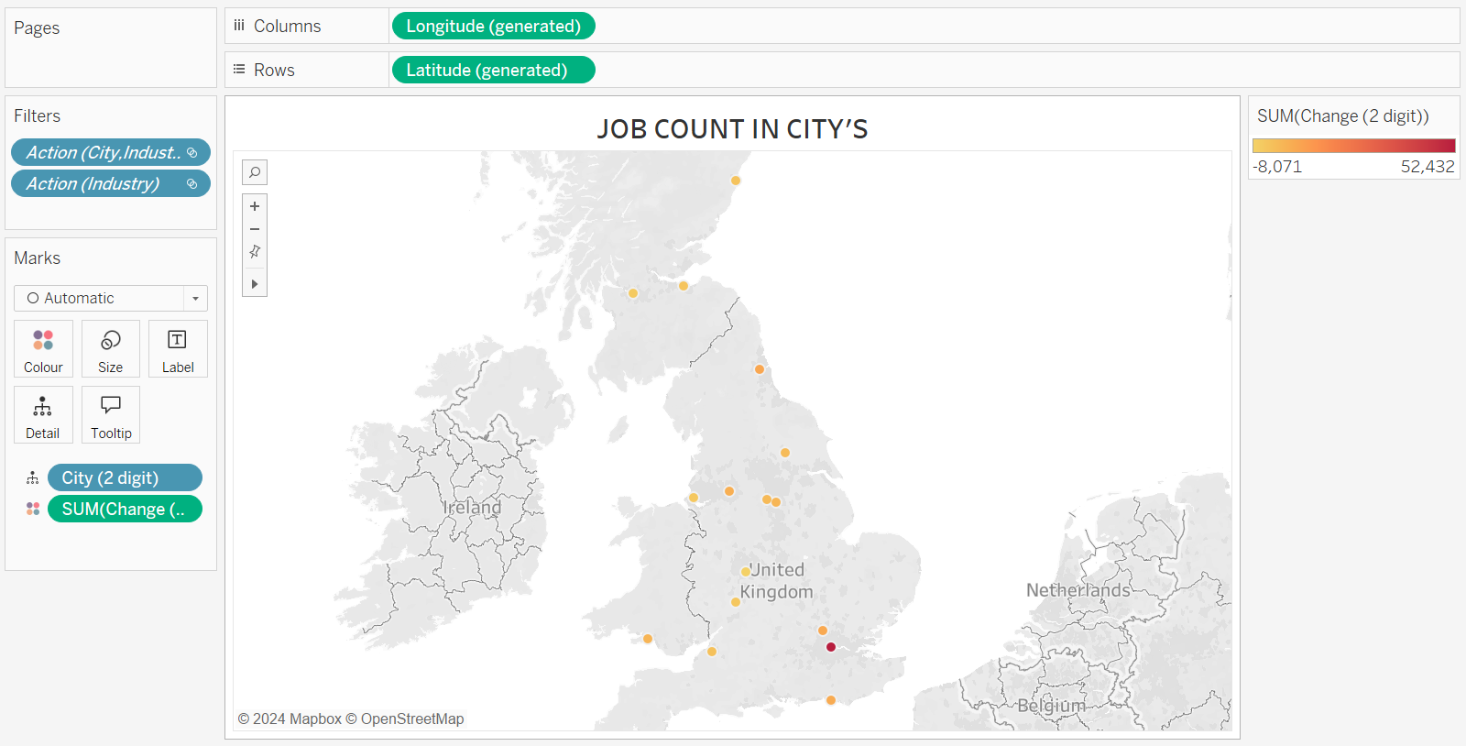

Slide 6
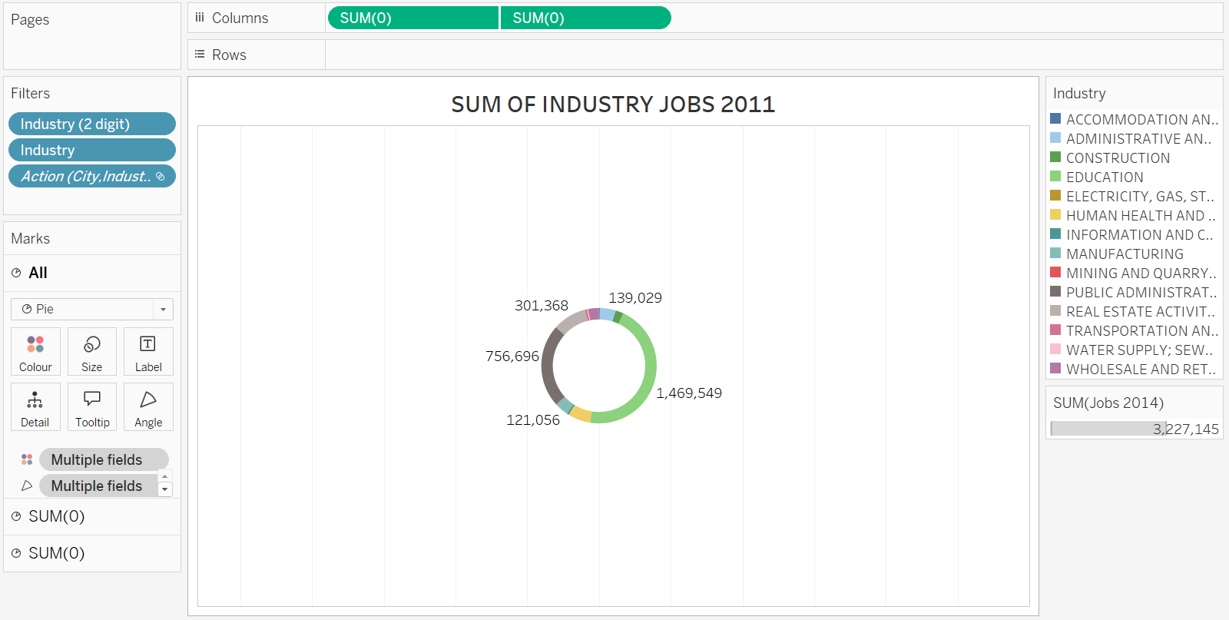

Slide 7
